Slide 1
Clustering Analysis of Lock Contention Fault Types Using Runtime Performance Metrics of Java Intrinsic Locks
Presenter: Nahid Hasan Khan (100770552)
Research Supervisors: Dr. Akramul Azim, Dr. Ramiro Liscano
Examining Committee Member: Dr. Sanaa Alwidian
University Examiner: Dr. Patrick Hung
Chair of Examining Committee: Dr. Jing Ren
Date: January 27th, 2022

Slide 2
Overview
Synchronization is essential in java based multi-threaded applications.
It provides the feature of accessing shared resources through threads and to avoid data inconsistency.
Despite its necessity, this mechanism introduces performance degradation if this is applied and managed improperly.
Two types of synchronization condition can cause performance issues; according to Brian Goetz [1]:
Threads spend too much time inside a critical section.
High frequency with which threads send access requests to the critical section or locked resources.
These are called contention faults not bugs as they prevent applications from scaling further.

Slide 3
Motivation
Although several methods and tools [2-11] are available to identify these two faults, they fail to distinguish between these two faults.
They need experienced performance engineers involvement and more human intervention to identify these faults interpreting from the runtime profile metrics.
Moreover, understanding contention types leveraging the metrics is not straightforward.
Therefore, an ML based automated synchronization-fault identification is necessary.
Notes:
With this mind we are intended to build a fault classifier with the goal of providing necessary information regarding the specific faults that lessen performance engineers efforts eventually.
In this thesis we showed that these faults can be classified based on the runtime performance metrics.

Slide 4
Objectives
Building a classifier needs dataset containing performance data, and this type of dataset (test purposes or real-world) is not available.
Therefore, our goal is to generate a dataset with performance values. (slides 7 - 13)
These data-points are unlabeled and hence our methodology introduces unsupervised learning approach to see whether the faults can be clustered based on the behavior of the performance values. (14 - 18)
Later an analysis is performed on the clusters to proof the hypothesis regarding these two faults. (19-27)

Slide 5
Related Works
Authors | Approach | How does it differ
Nathan R. Tallent et al. [9] | Call stack profiling and thread spinning profiling to detect performance loss. | Similar to ours but does not solve the issue of fault types identification.
Peter Hofer et al. [3] | Tracing locking events extracted from JVM to detect lock contention. | Tracing runtime logs but does not solve fault types identification.
Florian David et al. [2] | Proposed an approach called “Free lunch”, that measures critical section pressure (CSP) and the progress of the threads that impede the performance. | Failed to find correlation among performance metrics but we did.
E. Farchi et al. [10] | Proposed a static analysis to find bug patterns in the code. | Static analysis approach and does not solve fault types identification.
Sangmin Park et al. [11] | Dynamically locate concurrent programs, and locate data access patterns based on memory access patterns among threads. | Does not solve the fault types identification issue.
Chen Zhang et al. [12] | Implemented a static synchronization performance bug detection tool that detects critical section identifier, loop identifier, inner loop identifier, expensive loop identifier, and pruning component. | Does not solve the fault types identification issue

Slide 6
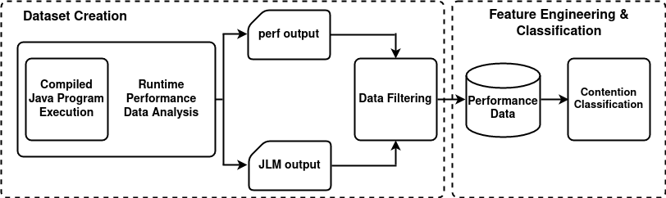
Architecture of the workflow
An updated version of workflow is included.
Reference of Figure 3.1.

Slide 7
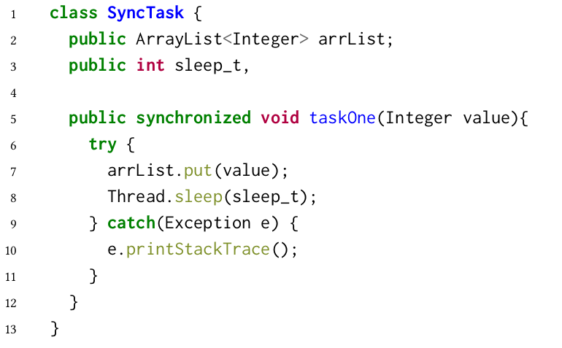
Dataset Creation
Executing concurrent program:
A concurrent example code is considered in order to emulate different types of contention.
The class SyncTask has a synchronized method (critical section).
The method is being called varying the threads and sleep times to emulate the contention.
The code is compiled before execution and test parameters (thread number and sleep value) are provided.

Slide 8
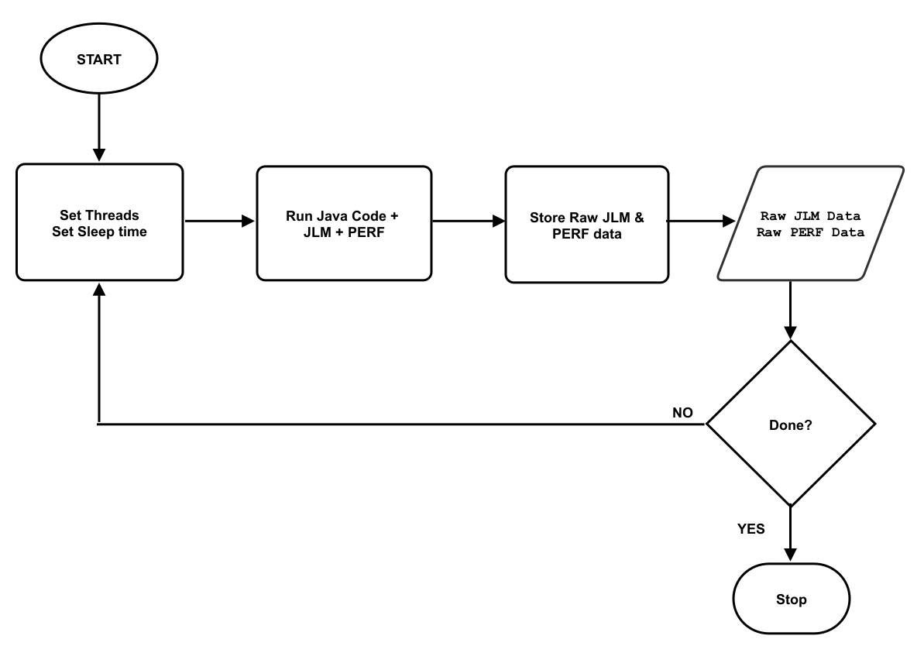
Dataset Creation Cont…
Automate Data Generation:
Executing program and generate a single data point is a tedious task and requires several terminal operations.
Hence, two bash algorithm-scripts is written to automate the process of generating.
Reference of Figure 3.6.

Slide 9
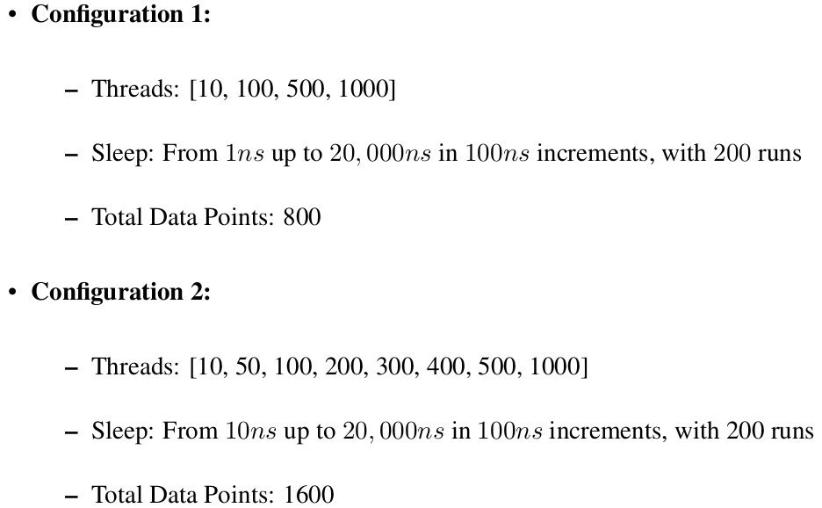
Dataset Creation Cont…
Test Formalization:
To generate dataset, two configurations are considered in the test formalization.

Slide 10
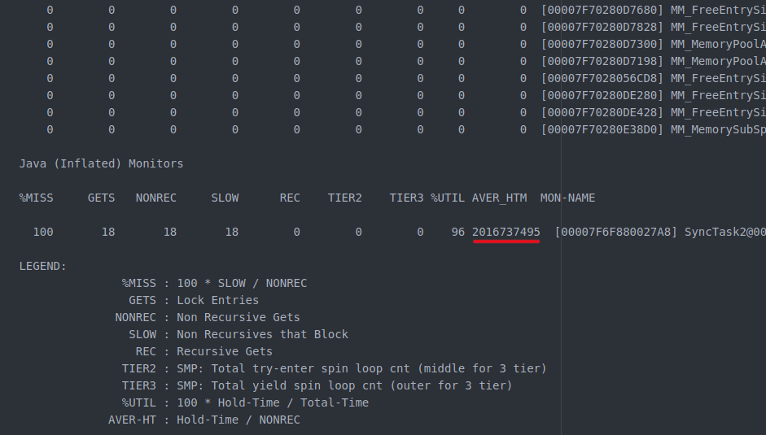
Dataset Creation Cont…
JLM file with contention stats
We are interested in “Java Inflated Monitors” only

Slide 11
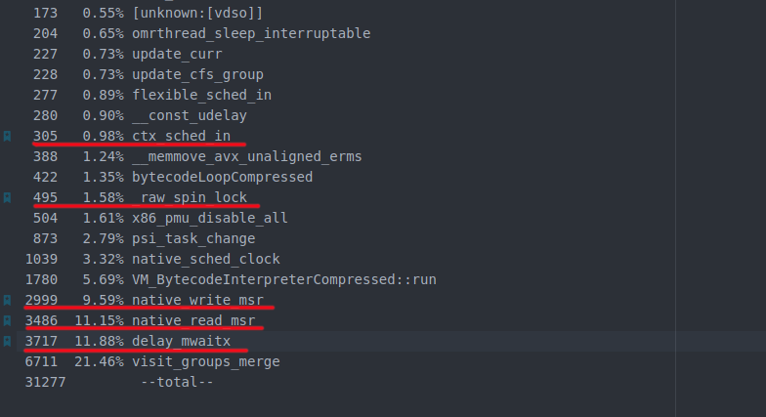
Dataset Creation Cont…
PERF file containing symbols
We are interested in symbols related to contention only

Slide 12
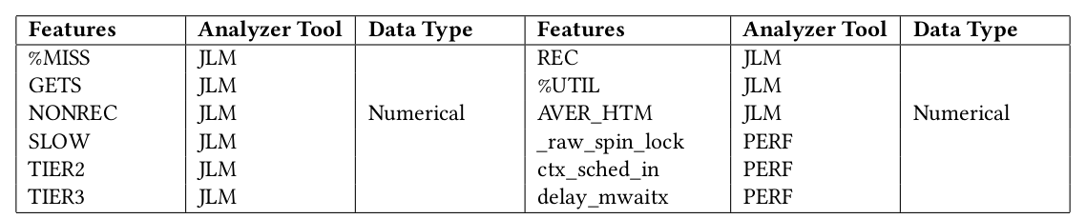
Dataset Creation Cont…
Aggregation & Filtering:
Raw PERF and JLM file contain data that are not related to contention.
Leveraging two algorithms written in Python, only useful information are parsed and collected.
At the end of this stage, the information are aggregated to a CSV file containing all the features from JLM and PERF.
Final Dataset:

Slide 13
Feature Engineering & Classification
Feature Engineering:
Feature engineering is essential and enhances the performance of a model or clustering performance.
To achieve that the followings are done:
Merged PERF and JLM features into one file.
Removed features that contain string values (e.g., the monitor name in JLM).
Removed feature that contain a value of zero.
Scaled the data. Scaling is applied to all the features utilizing the Python library StandardScaler from sklearn.preprocessing.
Removed less correlated features from the dataset after analyzing the heatmap.

Slide 14
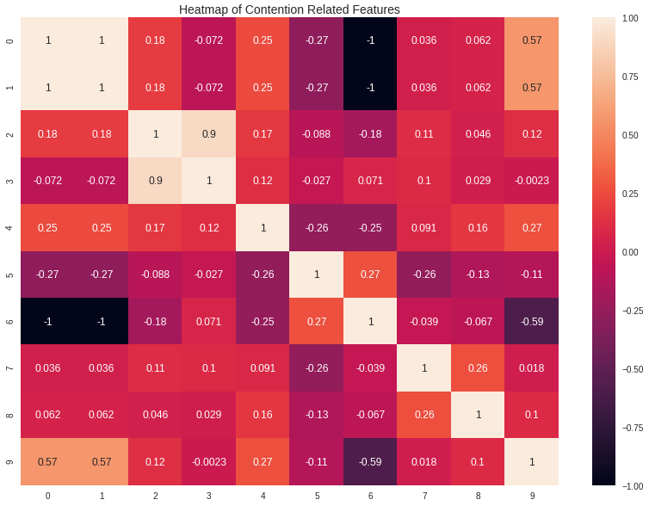
Feature Engineering & Classification Cont…
Heatmap analysis:
indices: GETS=0, NONREC=1, SLOW=2, TIER2=3, TIER3=4, %UTIL=5, AVER_HTM=6, _raw_spin_lock=7, _ctx_sched_in=8, delay_mwaitx=9.
Reference of Figure 3.8.

Slide 15
Feature Engineering & Classification Cont…
Applying PCA:
PCA is applied to reduce the dimensionality of the data and helps visualize the data by determining two primary components out of feature set.
PCA produces a dataset consisting of a 2-dimensional array of size 2400 x 2 on which the KMeans algorithm is performed.

Slide 16
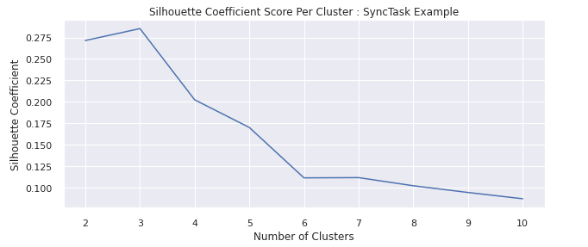
Feature Engineering & Classification Cont…
Determine Optimal Number of Clusters:
Most of the clustering algorithms require an argument for expected number of clusters to be specified prior to the clustering (k for KMeans).
Several popular methods are applied (e.g., Elbow method, Silhouette method etc) to determine this value. Most of them proposed that the ideal value for k = 3.
Hence, KMeans is applied with k = 3.
Reference of Figure 5.5.

Slide 17
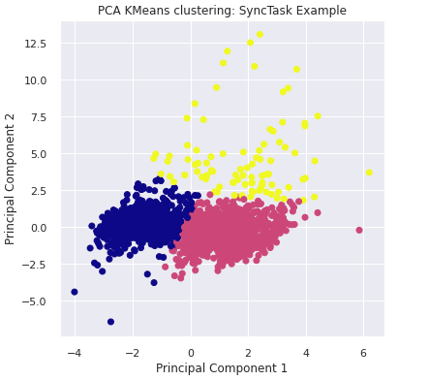
Analysis of The Clusters
KMeans extracts 3 clusters.
Reference of Figure 5.13.

Slide 18
Analysis of The Clusters
Semantic Labeling:
Extracted clusters are less informative and less useful as they are marked 0 to k-1 (k = number of clusters).
Hence, a final processing is required to label the each data point to its correspondent fault type after clustering.
To achieve this we merged the test parameters (e.g., threads, sleep time) to the final processed dataset and plotted them to a box plot to see the distribution of these parameters against the clusters.

Slide 19
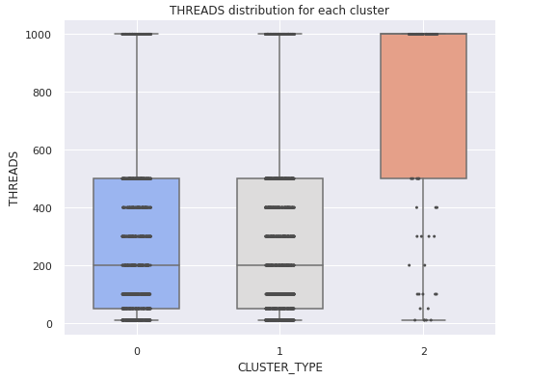
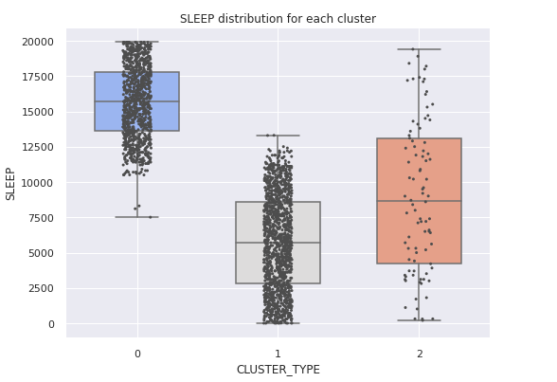
Analysis of The Clusters
Semantic Labeling:
As we expected fault type 2 is connected to high range of thread numbers, it can be seen in the graph of THREADS vs CLUTER_TYPE.
We expected fault type 1 is connected to high range of execution values (sleep value) and it is also proven analysing the SLEEP vs CLUSTER_TYPE graph.
References of Figures 6.1 and 6.2.

Slide 20
Analysis of The Clusters
Dominant Features:
To understand the faults better it is required to know the dominant features for each cluster.
These are the dishtinghusing factors that help performance engineers and developers to interpret the faults with ease.
To reveal the dominant features for the clusters, the KMeans extracted clusters are merged and mapped back to the original dataset and plotted them to the box plots.

Slide 21
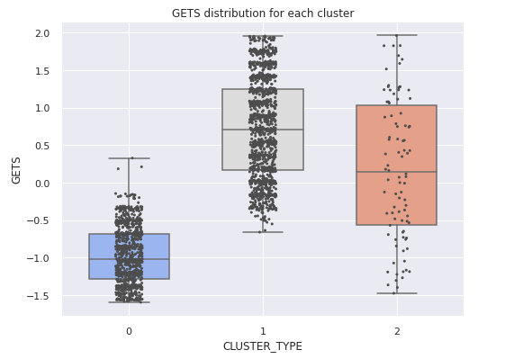
Analysis of The Clusters
Observing Feature Related to Lock Acquisition:
Metric related to lock acquisition such as GETS is a distinguishing factor for low contention cluster as the graph shows GETS distribution is higher for low contention cluster (CLUSTER_TYPE 1).
This is because if a lock is held by a thread long then others have to wait to obtain it and GETS value decreases. CLUSTER_TYPE 1 is low contention in the graph.
Reference of Figure 6.1.

Slide 22
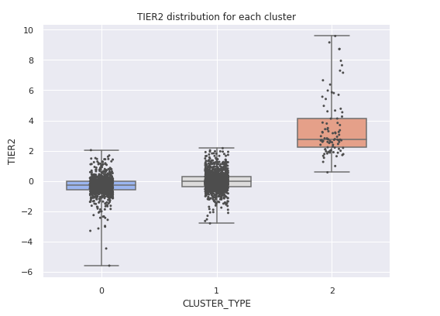
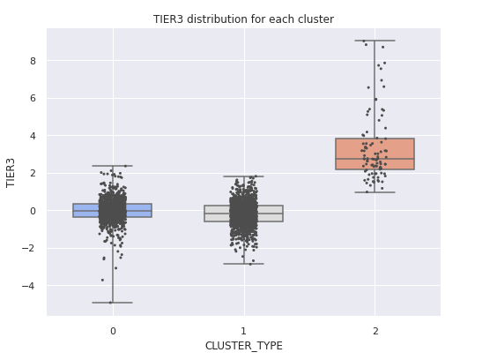
Analysis of The Clusters
Observing Feature Related to Spin-count:
Plotting the metrics related to spin-count (e.g., TIER2, TIER3) reveals that both features are high in range for CLUTER_TYPE 2.
This means in case of high-frequent requests, the spin-count metrics increase in number and are the distinguishing factors.
References of Figures 6.4 and 6.5.

Slide 23
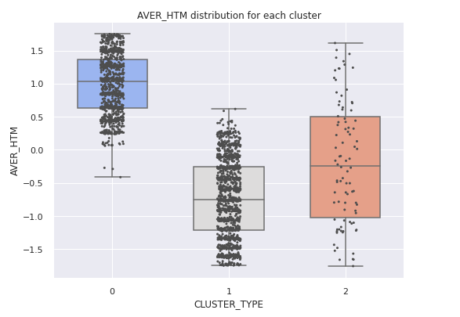
Analysis of The Clusters
Observing Feature Related to hold-time:
We always expect that hold-time feature such as AVER_HTM will be in high range for cluster representing fault type 1.
Hence, CLUSTER_TYPE 0 in our graph is the fault due to high hold time.
Reference of Figure 6.6.

Slide 24
Analysis of The Clusters
Statements:
Based on the observations the following statements can be made:
“Low Contention” has the low spinning counts (TIER2, TIER3) as well as low hold times (AVER_HTM) but the lock acquisition (GETS) is higher.
“Contention Fault 1” has low spinning counts but high in hold times.
“Contention Fault 2” has high spinning counts but low in hold times.

Slide 25
Discussions & Conclusions
Despite some other limitations such as OS and JVM compatibility, the primary limitation of our work is the lack of a real-world dataset.
To prove our hypothesis regarding the two primary faults, we generated some synthetic data executing a java concurrent code.
As we have proven, we believe this technique can be applied on a real-world dataset to classify the contention types.

Slide 26
References
[1] Goetz, B., Peierls, T., Bloch, J., Bowbeer, J., Lea, D., & Holmes, D. (2006). Java concurrency in practice. Pearson Education.
[2] Florian David, Gaël Thomas, Julia Lawall, and Gilles Muller. 2014. Continuously measuring critical section pressure with the Free-Lunch profiler. Proceedings of the Conference on Object-Oriented Programming Systems, Languages, and Applications, OOPSLA 49, 10 (2014), 291–307. https://doi.org/10.1145/2660193.2660210
[3] Peter Hofer, David Gnedt, Andreas Schörgenhumer, and Hanspeter Mössenböck. 2016. Efficient tracing and versatile analysis of lock contention in Java applications on the virtual machine level. ICPE 2016 - Proceedings of the 7th ACM/SPEC International Conference on Performance Engineering (2016), 263–274. https://doi.org/10.1145/2851553.2851559
[4] Sangmin Park, Richard W. Vuduc, and Mary Jean Harrold. 2010. Falcon: Fault localization in concurrent programs. Proceedings - International Conference on Software Engineering 1 (2010), 245–254. https://doi.org/10.1145/1806799.1806838
[5] IBM Corporation. 2007. IBM Monitoring and Diagnostic Tools - Health Center. https://www.ibm.com/docs/en/mon-diag-tools?topic=monitoring-diagnostic-tools-health-center
[6] YourKit. 2003. YourKit Java Profiler. https://www.yourkit.com/java/profiler/features/
[7] Ej-technologies GmbH. 2001. The Award-Winning All-in-One Java Profiler. https://www.ej-technologies.com/products/jprofiler/overview.html
[8] Oracle Corporation. 1993. Visual VM. http://visualvm.java.net/

Slide 27
References
[9] Nathan R. Tallent, John M. Mellor-Crummey, and Allan Porterfield. 2010. Analyzing lock contention in multithreaded applications. ACM SIGPLAN Notices 45,5 (2010), 269–279. https://doi.org/10.1145/1837853.1693489
[10] Eitan Farchi, Yarden Nir, and Shmuel Ur. 2003. Concurrent bug patterns and how to test them. In Proceedings international parallel and distributed processing symposium. IEEE, IEEE, Nice, France, 7—-pp.
[11] Sangmin Park, Richard W. Vuduc, and Mary Jean Harrold. 2010. Falcon: Fault localization in concurrent programs. Proceedings - International Conference on Software Engineering 1 (2010), 245–254. https://doi.org/10.1145/1806799.1806838

Slide 28
Thank You

Slide 29
Recommendation for Faults
Recommendations for fault 1:
Omitting expensive operations or calculations in the critical sections that consume extra execution times can reduce holding the lock for long.
Avoiding synchronized method.
Applying read-write lock. Open to read but close to write.
Applying java.util.concurrent containers.
Recommendations for fault 2:
Avoiding synchronized method.
Splitting the lock.
Stripping the lock
Applying read-write lock
Applying java.util.concurrent containers

Slide 30
Dataset Creation Cont…
Metrics of Performance Analyzers:
While java concurrent program is executing, two performance analyzers (PERF and JLM) are activated to collect the necessary runtime performance profile data.
JLM Metrics:
GETS: Total number of successful acquires. GETS = NONREC (Non recursive GETS) + REC (recursive GETS).
NONREC: Total number of non-recursive acquires. This number includes SLOW GETS.
SLOW: Non recursive that block.
REC: Recursive GETS (thread requests for lock and already acquired it).
TIER2: On platforms that support 3-layer spin locks, the number of inner loops to obtain locks.
TIER3: On a platform that supports 3-layer spin locks, the number of cycles in the outer layer to obtain the lock.
%MISS: Percentage of the total GETS (acquires) where the requesting thread was blocked waiting on the monitor. %MISS = (SLOW / NONREC) * 100.
%UTIL : Monitor hold time divided by total JLM recording time. %UTIL = 100 * Hold-Time / Total-Time.
AVER-HTM : Average amount of time the monitor was held. AVER_HTM = Hold-Time / NONREC.
PERF Metrics:
_raw_spin_lock
ctx_sched_in
delay_mwaitx

Slide 31
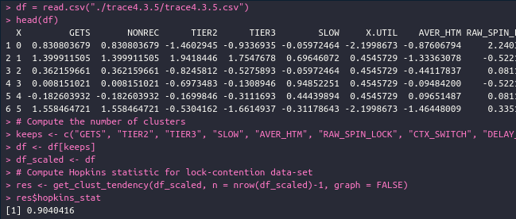
Feature Engineering & Classification
Validating Clustering Approach:
Three factors to validate clustering process:
“Assess clustering tendency” sees whether data is clusterable
“Relative clustering validation” confirms the optimal number of clusters varying the parameters of the algorithm.
Assess Clustering Tendency:

Slide 32
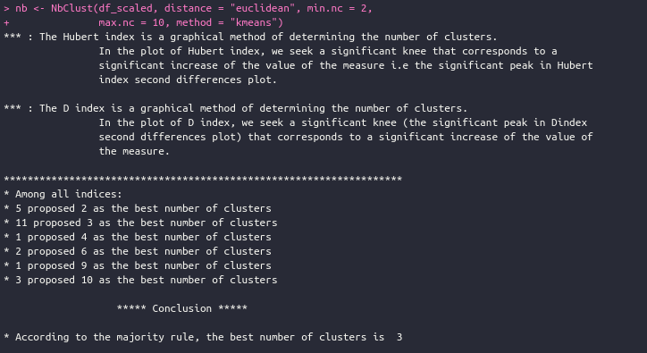
Feature Engineering & Classification
Relative Clustering Validation:

Slide 33
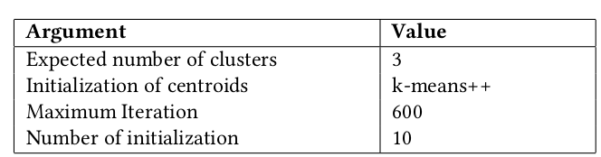
Feature Engineering & Classification Cont…
Applying KMeans:
The KMeans is performed on the final processed dataset (With the PCA values).
Besides the value for k, some other arguments of KMeans are provided to enhance and accelerate the clustering performance.
Initialization of the centroids is to instruct KMeans to find the efficient solution of selecting centroids instead of defining them by us.
Number of initialization defines the number of times KMeans should alter centroid seeds.
Maximum iteration defines the number of times KMeans should run before choosing the best solution.

Slide 34
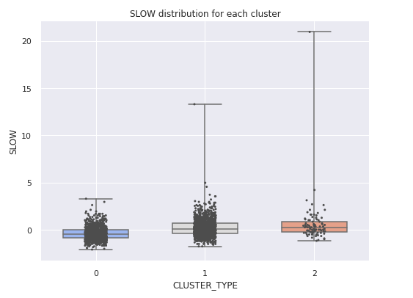
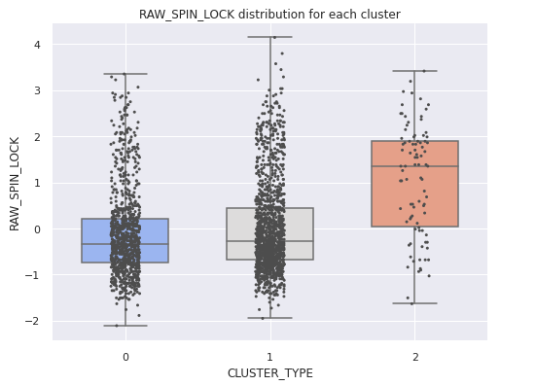
Analysis of The Clusters
Observing Other Features:
The other features overlaps more and we could not find any distinguishing factor observing them.

Slide 35
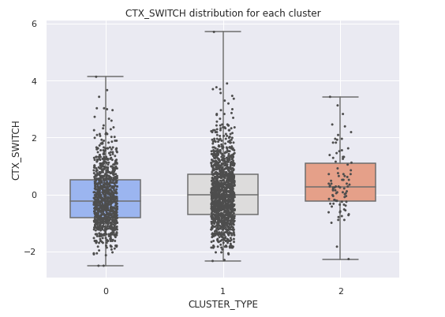
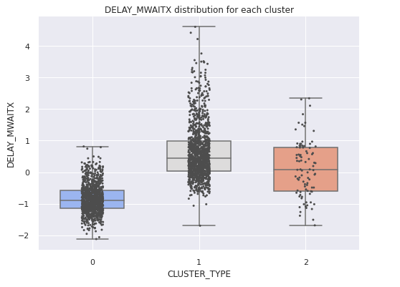
Analysis of The Clusters

